Slide 1
RRHOA
Member Audit Committee
Audit Report: Unpaid Dues

Slide 2
Disclaimer
All Member Audit Committee (MAC) reports have been compiled using resources made available to the MAC by the RR HOA BOD and bookkeeper, Karen Burback. The MAC has attempted to be as accurate and complete as possible in the analysis of data and production of this report. However, nothing in this report should be considered final or absolute as the MAC makes no such claims. The MAC encourages users of this report to verify and confirm all data.
Nothing in this report is to be used or interpreted in any way as a legal or official statement by the MAC.
Backup data and documentation used to produce this report can be provided upon request.
The MAC consists of HOA member volunteers not experienced or professional auditors.

Slide 3
Data, Records, and Sources
QuickBooks deposit data from Karen Burback
  Data begins 9/1/2006
Lot numbers, owners, purchase and sale dates
  Gilpin County Assessor Data Site, RR HOA Member Meeting Presentations
Amount of monthly HOA dues owed from 2006-2019
  Deposit data, Karen Burback, Gilpin County Assessor Data Site, RR HOA Member Meeting Presentations

Slide 4
Process
Calculate the total amount of HOA dues owed by each member based on the time period each lot was owned between 9/1/06 and 12/31/19.
Compare total amount of HOA dues owed by each member to the total amount paid by each member between 9/1/06 and 12/31/19.
Determine an acceptable variance between the amount owed and amount paid to allow for discounts, credit card fees, and other related variables. Flag variances exceeding the acceptable threshold.
  Flagged top 10% variances, indicating unpaid dues.
  Flagged bottom 5% variances, indicating overpayment of dues or potential error.
For each flag, determine and note reason for variance.

Slide 5
Notes Re: Scott Schorer/Lone Pine, Ted Bertele, and Lots 1, 2, & 3
Scott Schorer’s intention early in the development of Roosevelt Ridge was to maintain ownership of Lots 1, 2, and 3*. However, at some point in time, Schorer’s plans changed to include Ted Bertele.
Schorer and Bertele have a personal and familial relationship. As such, the operational details of all matters related to lots 1, 2 and 3 are personal and private to Schorer and Bertele and shall appropriately remain as such.
To avoid any erroneous assumptions or errors, the MAC has combined lots 1, 2, and 3 and owners Bertele and Schorer for the purposes of this report unless otherwise noted. It is the right and responsibility of Mr. Schorer and Mr. Bertele to determine allocations based on the details of their private agreements.
Additionally, the names Lone Pine and Scott Schorer, as sole owner of Lone Pine, may be used interchangeably throughout this report.
*See Appendix Slide titled “Lone Pine/Bertele: Lots 1, 2, & 3”

Slide 6
Report Summary

Slide 7
Report Objectives
Determine if current RR HOA members have paid all HOA dues owed as of 12/31/19.
If not:
  What is the unpaid balance due?
  What action has the HOA taken to collect unpaid dues?
  What penalties applied? Were they consistent to all members?
NOTE: It is important to note that this report does NOT include potential back dues owed by Lone Pine for lots other than 1, 2, and 3. It was pointed out to the BOD multiple times in March 2020 that Scott Schorer was not paying dues on the lots for which he was using for voting privileges. Given Lone Pine's use of voting privileges, an independent auditor could argue that Lone Pine owes for more than three lots.

Slide 8
Results
Have all current members paid HOA dues?
  No. Bertele/Schorer have balances due on lots 1, 2, and 3.
What is the unpaid balance due?
  $52,300
  What action has the HOA taken to collect unpaid dues?
  A letter was sent in 2020.
  What penalties applied? Were they consistent to all members?
  In 2020, the BOD (Bertele, Mayberry, Wallace) assessed a $50 late fee to both Bertele & Schorer.
  This action was NOT consistent with past HOA action taken. Precedent for appropriate BOD response to unpaid dues was set by Schorer when the RR HOA took legal action against Orie Fontaine. See detailed slides further in this presentation.
NOTE: Kennedys (lot 22) have an unpaid balance due of $1,550. However, lot 22 has not been annexed into the HOA and therefore is not obligated to pay HOA dues.

Slide 9
Report Details

Slide 10
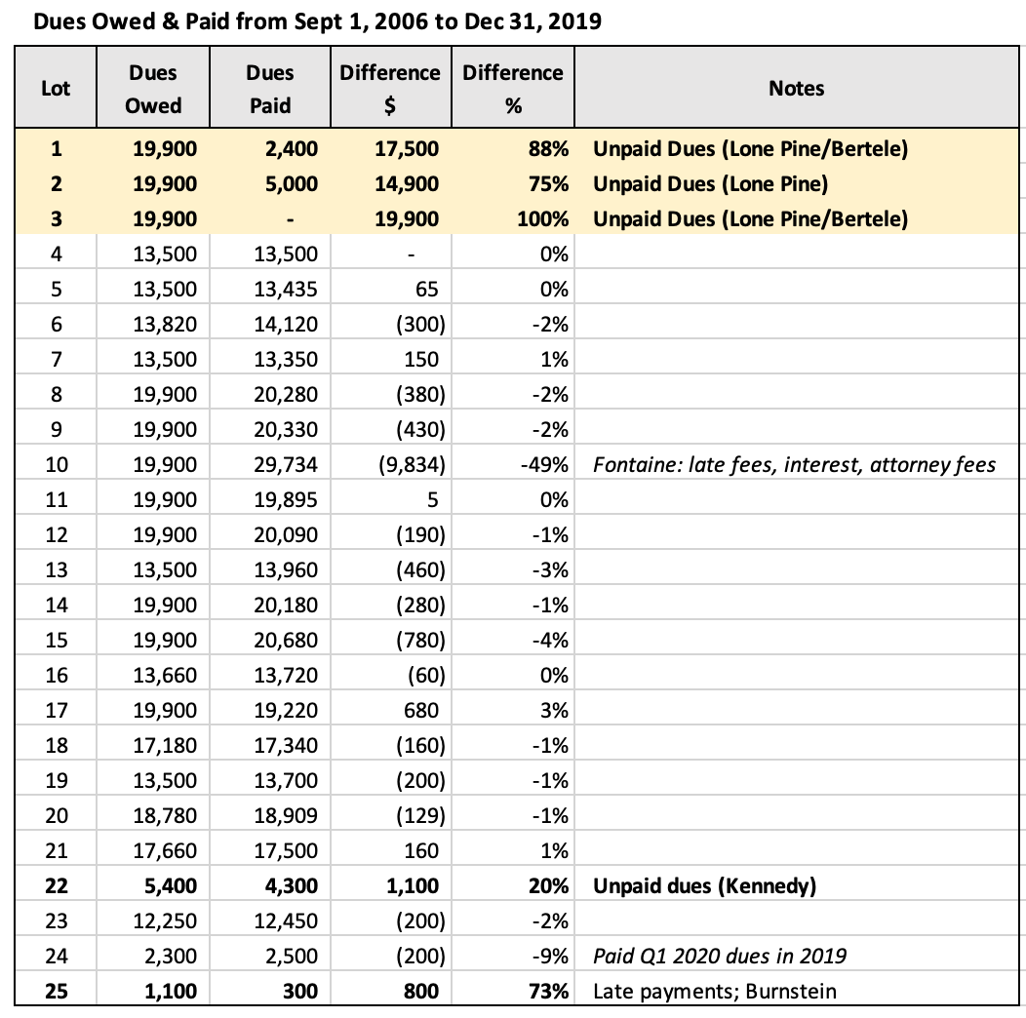
Unpaid Dues by Lot
  Lot #1: Bertele/Lone Pine
  Lot #2: Lone Pine
  Lot #3: Bertele/Lone Pine
NOTE [1] Kennedys (lot 22) are not HOA members.

Slide 11
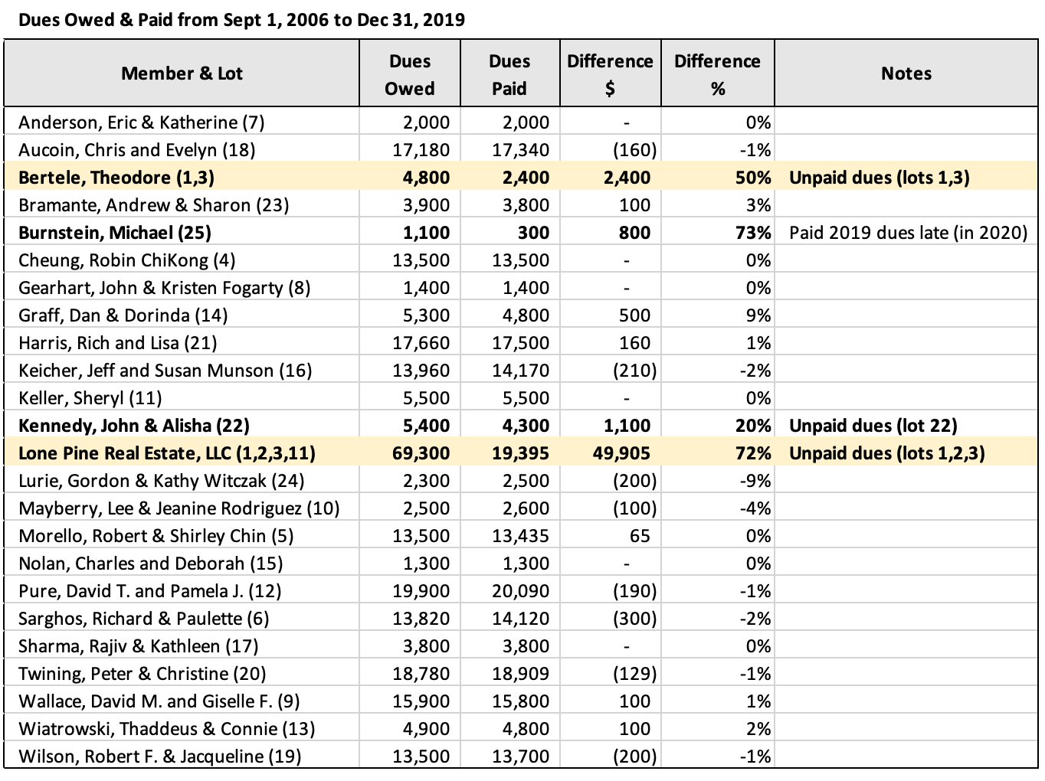
Unpaid Dues by Member
  Bertele
  Lone Pine
NOTE [1] Amounts calculated based on time periods of lot ownership according to Gilpin County Assessor Data Site.
NOTE [2] Kennedys are not HOA members.

Slide 12
Total Unpaid Dues
Results
  Lot #1, Schorer/Bertele: No dues paid from Sept 2006 to Dec 2017, totaling $17,500
  Lot #2, Schorer: No dues paid for Sept 2006 to Dec 2015, totaling $14,900
  Lot #3, Schorer/Bertele: No dues ever paid (Sept 2006 to Dec 2019), totaling $19,900
  TOTAL UNPAID DUES FOR LOTS #1, #2, #3, Schorer/Bertele = $52,300
Note: Data as of 12/31/2019

Slide 13
Precedent for Unpaid Dues

Slide 14
Penalties for Unpaid Dues
  Lot #1 (Schorer/Bertele) unpaid dues: Oct 2005 to Mar 2018, totaling $19,560
    Penalty: $0, Unpaid Balance Due: $19,560
  Lot #2 (Schorer) unpaid dues: Nov 2010 and Apr to Dec 2015, totaling $1,125
    Penalty: $50, Unpaid Balance Due: $1,125
  Lot #3 (Schorer/Bertele) unpaid dues: Oct 2005 to Dec 2019, totaling $21,960
    Penalty: $50, Unpaid Balance Due: $21,960
  Lot #10 (Fontaine) unpaid dues: 2008 to May 2010 (when lien was initiated), totaling $3,365
    Penalty: $9,778, Unpaid Balance Due: $0
Note: Penalty amounts for Lots 1, 2, and 3 were determined in August 2020. All other data as of 12/31/2019.

Slide 15
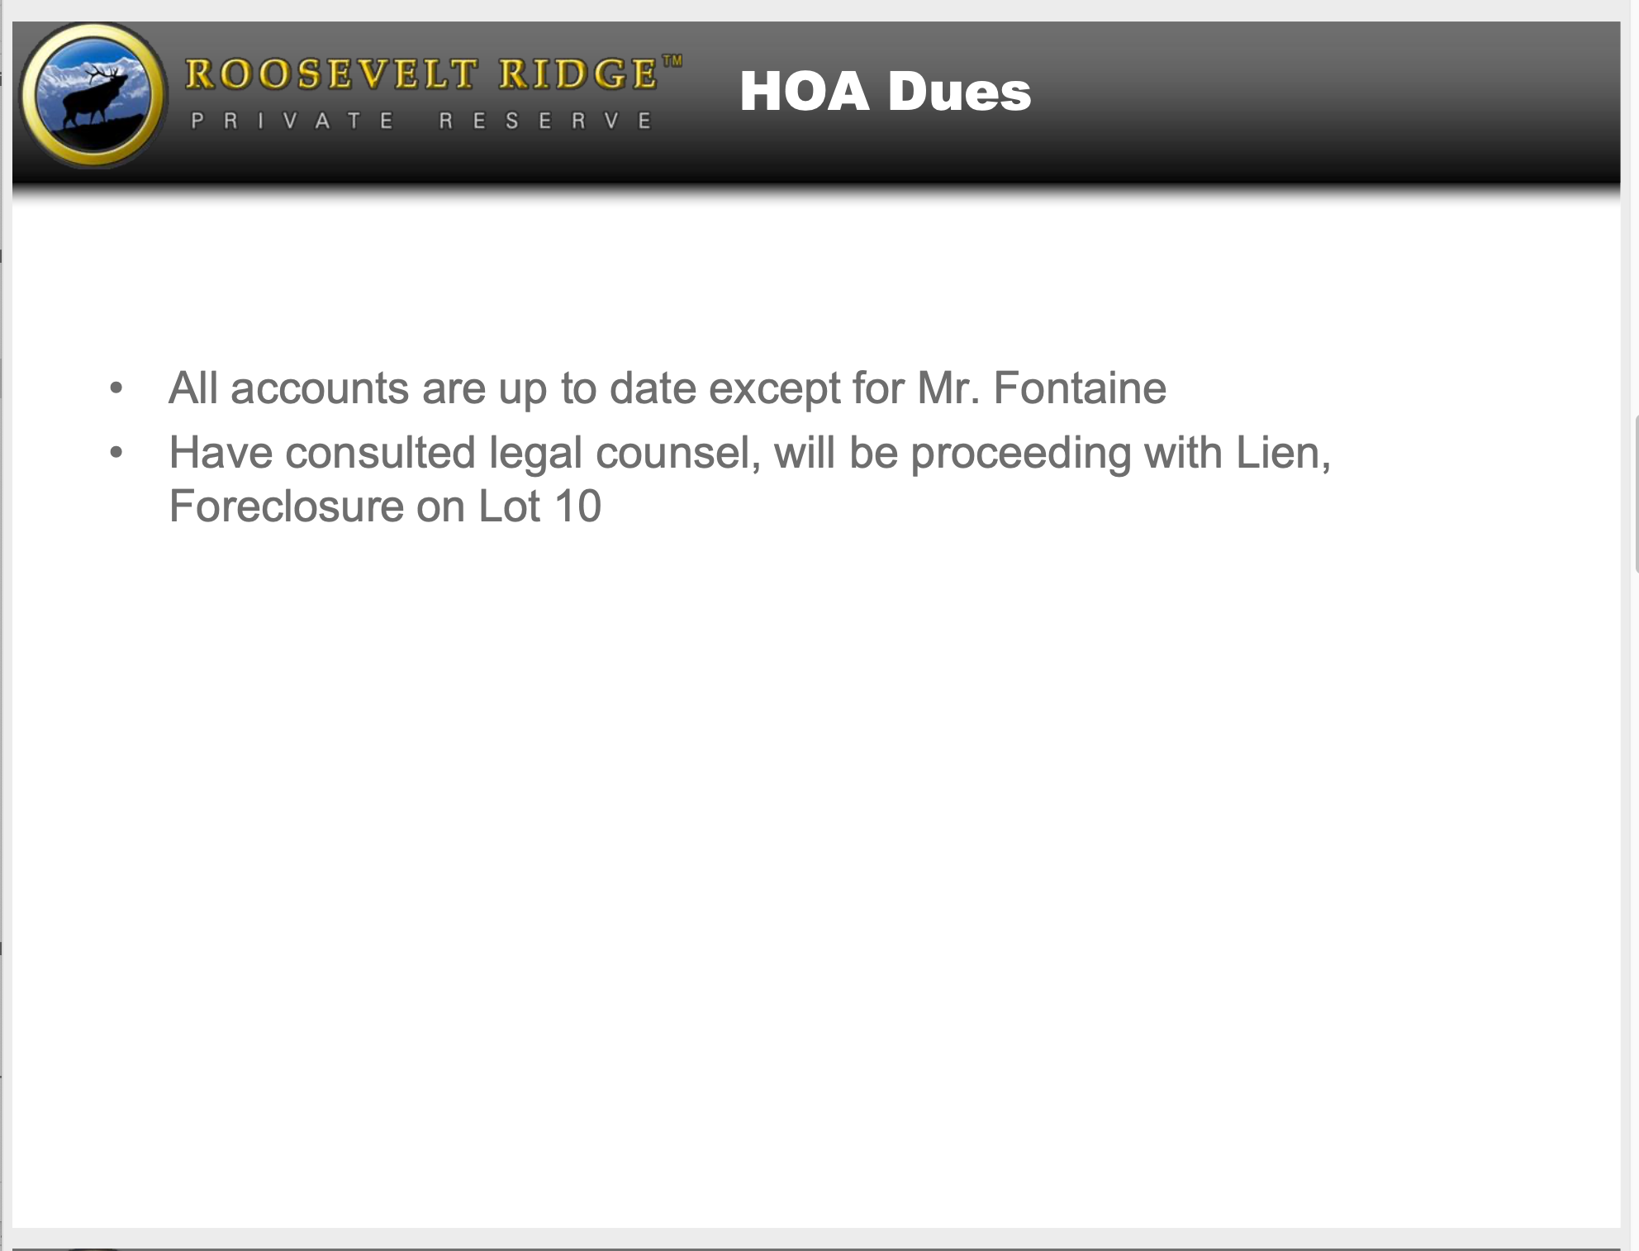
Precedent for Unpaid Dues
Other than Mr. Schorer (Declarant & Board Director, 2005 to 2018) and Mr. Bertele (Board Director, 2018 to present), there has only been one other instance of unpaid owner dues: Orie Fontaine.
As of 5/31/10, Lot #10 owner, Mr. Fontaine, had an unpaid HOA dues balance of approx. $3,665. Mr. Schorer consulted legal counsel (billing Mr. Fontaine for legal fees) and was proceeding with a lien on Mr. Fontaine’s lot.
Source: 6/18/10 Member Meeting Presentation

Slide 16
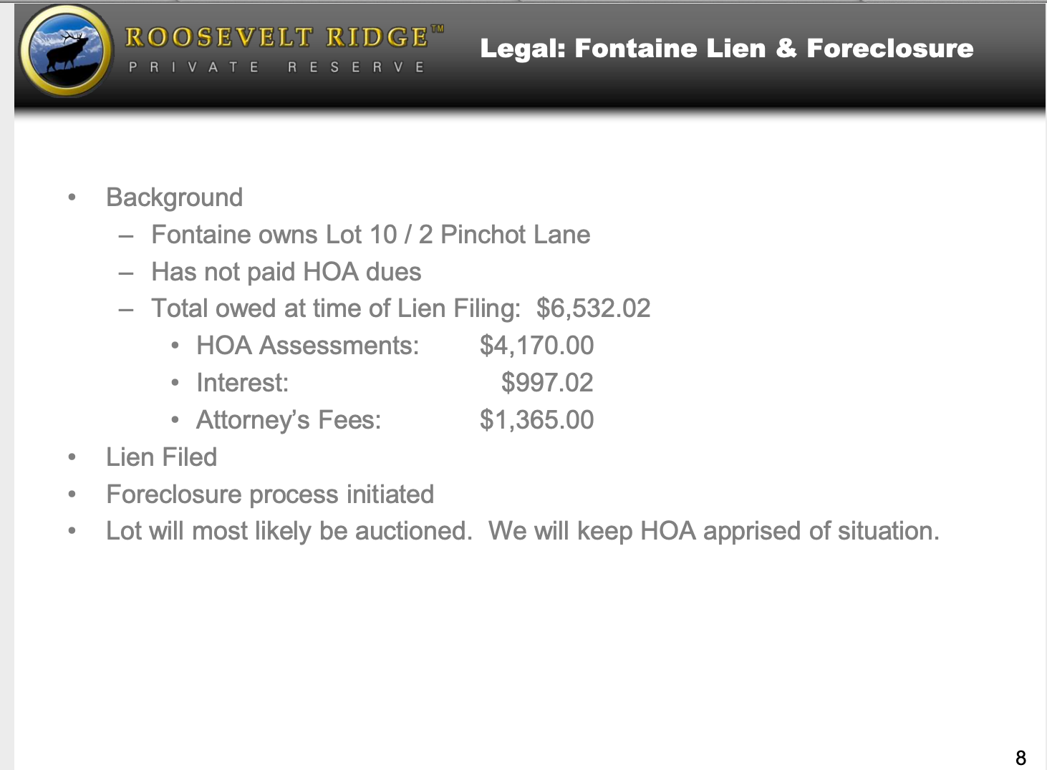
Precedent for Unpaid Dues
As of 12/10/10, Mr. Fontaine had an unpaid HOA dues balance of $4,170.
By this point, Mr. Schorer (on behalf of the HOA) has taken the following actions:
  Filed a lien and initiated the foreclosure process with the expectation of auctioning Mr. Fontaine’s lot.
  Added attorney’s fees to Mr. Fontaine’s total amount owed.
  Added an interest accrual rate of 18% to both the unpaid HOA Assessments balance and the attorney’s fees.
Source: 12/10/10 Member Meeting Presentation

Slide 17
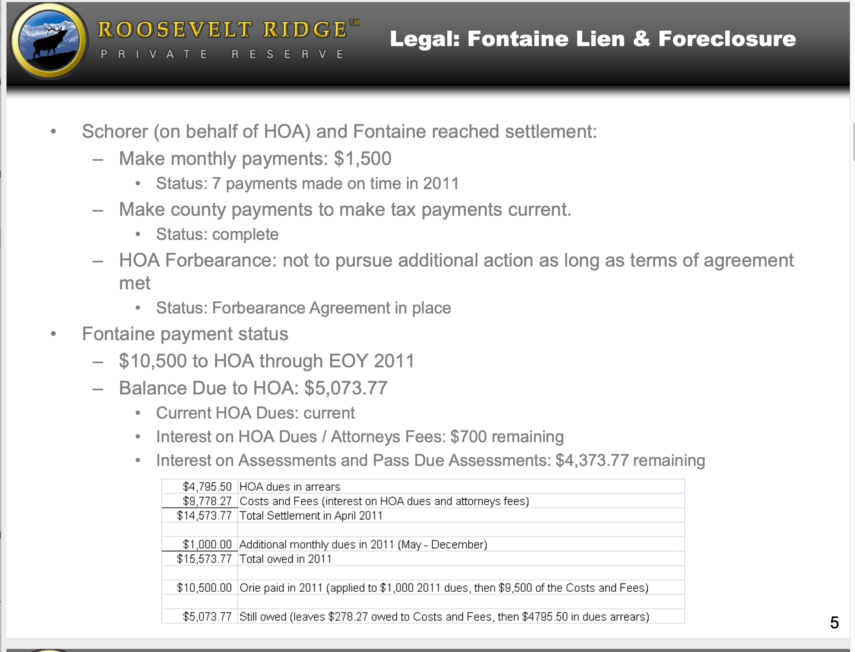
Source: 1/13/12 Member Meeting Presentation
Precedent for Unpaid Dues
Mr. Schorer settled with Mr. Fontaine for $9,778 in costs & fees
Mr. Fontaine made 10 payments for $1,500 each between June 2011 to June 2012. By the end of 2012, with 2 more payments totaling $2,074, Mr. Fontaine was current.

Slide 18
Conclusion

Slide 19
Conclusion
  Scott Schorer acted on behalf of the RRHOA by initiating a lien against Lot #10 (Fontaine) by the time Mr. Fontaine’s unpaid balance reached $3,365. Schorer was a member of the BOD at the time.
  As of 12/31/19, Schorer/Bertele unpaid balances reached $53,300 with no action taken. By 12/31/20, both Bertele and Schorer were penalized $50. Bertele was a member of the BOD at the time.
    Mr. Schorer’s former position as Declarant and Board Director and Mr. Bertele’s current position as Board Director appears to be a contributing factor to this discrepancy since the BOD has absolute control over who receives penalties for unpaid dues.
    The structure of the current BOD has no process in place to ensure the BOD is adhering to the bylaws and guidelines as stated in the RR HOA governing documents.

Slide 20
Appendix

Slide 21
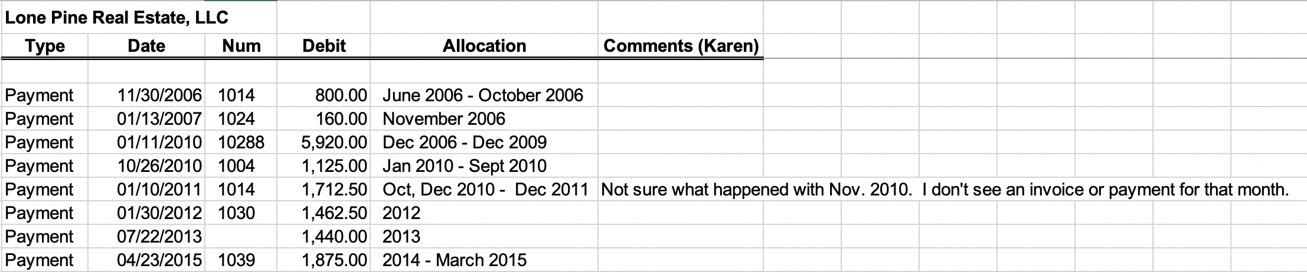
Lone Pine: Lot #11
Lone Pine purchased lot #11 from Kaisers on 6/7/06 and sold it to Keller on 5/29/15.
Lone Pine paid lot #11 dues in full with the exception of November 2010.
These payments were previously incorrectly believed to have been for lot #2.
The allocation information is from Karen Burback.

Slide 22
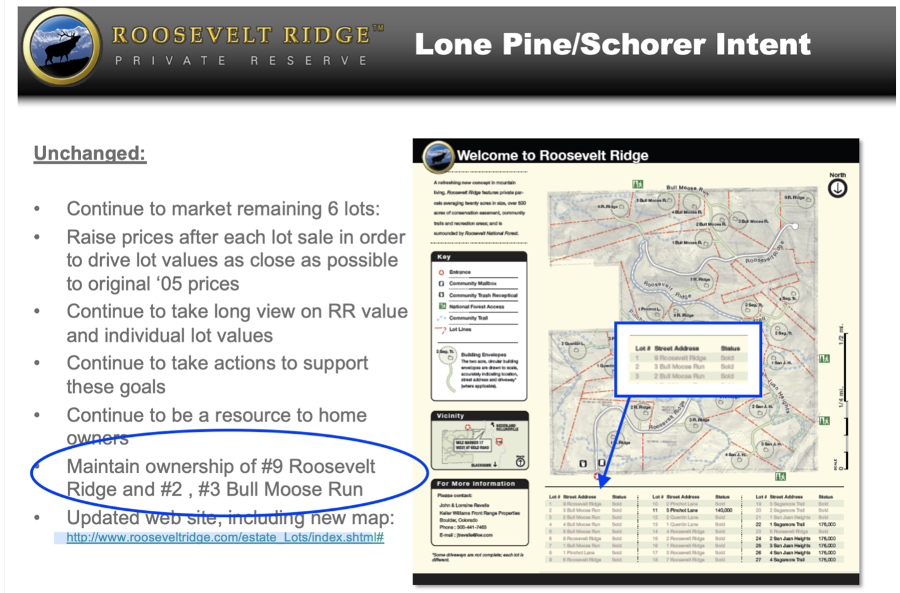
Lone Pine/Bertele: Lots 1, 2, & 3
As early as February 7, 2013:
Schorer declared lots 1, 2, and 3 as “Sold”
”Lone Pine/Schorer Intention” was to “Maintain ownership of #9 Roosevelt Ridge and #2, #3 Bull Moose Run” (lots 1, 2, and 3)
However, Schorer has only paid dues on lot 2. The 1st payment was made in March 2017.
This payment covered January 2016 to March 2017.
SOURCE: RR HOA Members Meeting Presentation 2/7/2013

