Slide 1
HOA Meeting DATE
Cistern Discussion
Roosevelt Ridge HOA
Presented to Timberline Fire Protection District and updated with comments

Slide 2
Gilpin County / Timberline Fire Requirement
“The Owners will construct two 30,000-gallon community water cisterns to be used for fire suppression. The first cistern shall be constructed prior to the completion of 25% of the homes on the Property and the second cistern shall be constructed upon completion of 50% of the homes on the Property. The location of the cisterns shall be pre-approved by the Fire Protection District.”
Order for Inclusion of Real Property in the Colorado Sierra Fire Protection District, January 29, 2006
Roosevelt Ridge has 7 completed homes, one unit is under construction
Final buildout is limited to 27 units (resolution 10-31), 25% is 6.75 units
Roosevelt Ridge HOA is working to meet the initial cistern requirement by providing a project plan with milestones to allow owners to continue building while ensuring our obligations are being met.

Slide 3
Requirements
Requirements
ISO rating mandates 30,000 gallons minimum
6 in NST attachment fitting
Freeze protection of tank and lines
Vehicle Access
County documents mandate a 30k gal cistern after 25% occupancy (6 units)
Additional 30k gal at 50% occupancy (13 units)
Buried below frost line or heated tank
Others?
Desirements (RR or TFPD)
Below ground (RR)
Gravity assist flow (TFPD)
Others?
Other Discussions
TFPD not party to sprinkler requirements
TFPD not interested in a fire structure at RR, not a good location and an existing structure exists just down the road
TFPD is in the process of evaluating the need for a second 30K cistern
7/16/19: TFPD Board supports the removal of language regarding sprinkler requirements and fire structure but this is a County decision.
* From 6/17/19 meeting

Slide 4
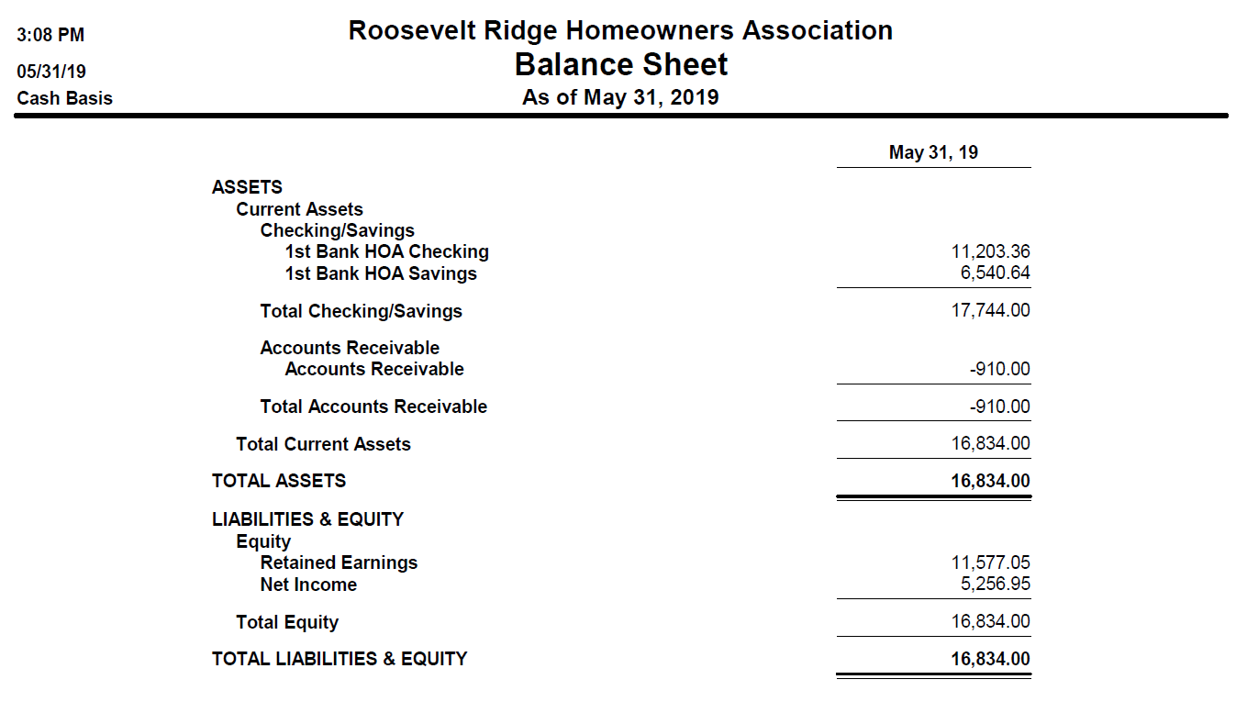
HOA Balance Sheet – limited reserves
Cistern funding will require a Special Assessment
Vote for Special Assessment in October 2019 after final quotes received
Actual funding may be delayed for litigation
Goal to have available funds by late 2021 or early 2022

Slide 5
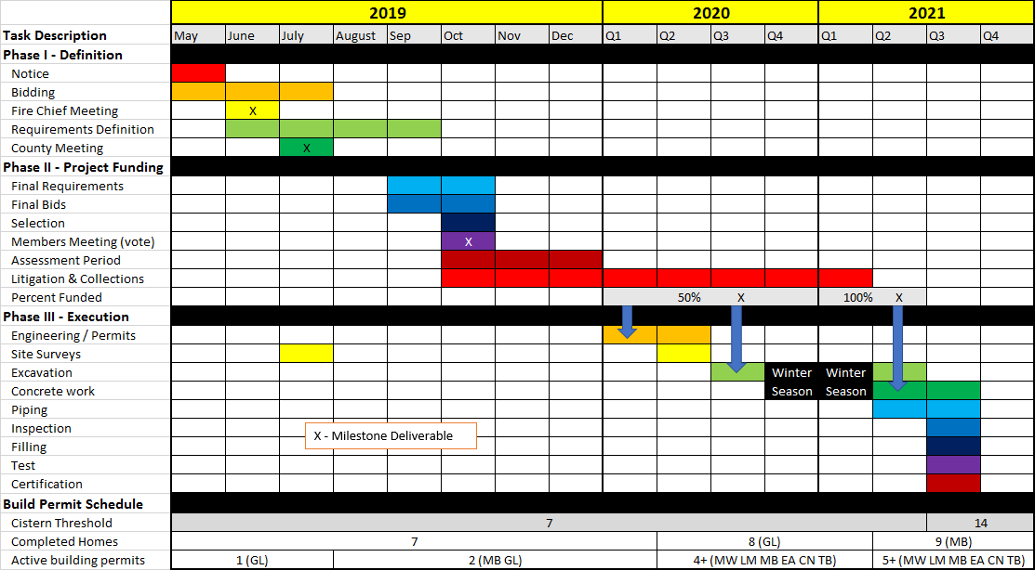
HOA Proposed Schedule Discussion

Slide 6
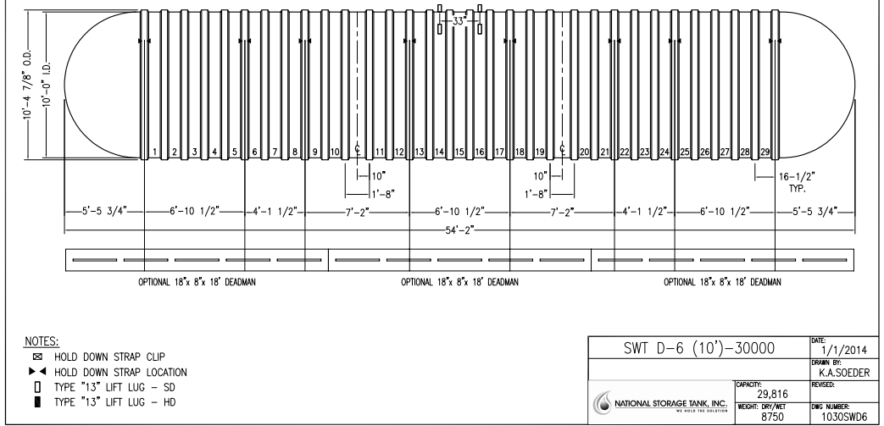
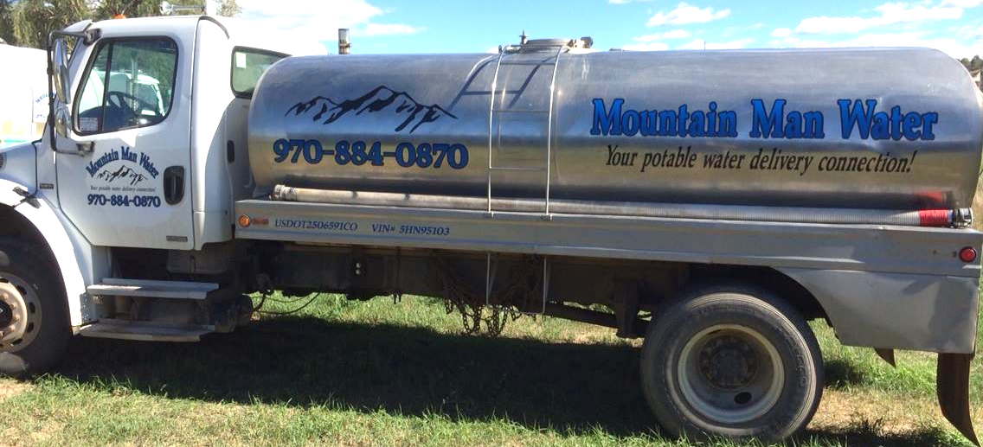
Buried Tank: $126k
Tank Supplier – National Storage Tank, Inc.
10’ 30,000 gallon tank
Fire set up with dry hydrant assembly and vent - $48k to $52k
Anchoring - $13,500
Shipping (2 trucks) - $8,400
Delivery est, 10 weeks ARO (EOM August)
Subtotal: $71,900
Installation estimate via Black Diamond
Excavation (12w x 14D x 48L / 300 yds) $24K
Blasting or rock breaking $10k (+/- $5k)
70+ yards of sand or other material sourced and delivered $8k
Excavated Material Hauling (250 yds) $6k
Road work to access site $4k
Subtotal: $52k
Water delivery 0.085 / gallon = $2,550

Slide 7
Pour in Place Concrete Cistern: $90k
Pat Thomas Tcs-Toma Construction Services Inc
$40k for 30,000-gal tank (estimate)
Previous projects include
Sunshine Canyon Fire Station cistern
Coyote Hotel, Black Hawk
Concrete forms, 12 in tank walls and lid
Connections included
Additional Items
Plumbing / Fixtures ($tbd)
Liner or coating ($tbd)
Tank interior is 8 x 35 x 15ft (est)
4,200 cuft
31,500 gal
Can modify depth / dimensions based on topography and difficulty in excavation (rock…)
70 yards of concrete, 8-10 truckloads (est)
Rebar, wire mesh, ect
Excavation $45K
Identical to previous approach
More flexible, as the container can be modified to fit the topography
7/16/19: TFPD Board likes this approach.

Slide 8
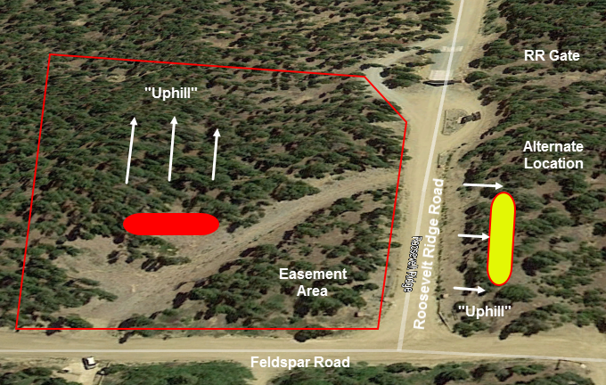
Proposed Cistern Locations
Easements in place to support fire fighting equipment at this location
Good access that includes a turn around
Tank could be placed into the hill providing gravity assist flow to a hydrant further below
Alternate location on the West side of RR Rd
Additional consideration given to placement further up RR Rd, (centralized)
N

Slide 9
Backup Slides

Slide 10
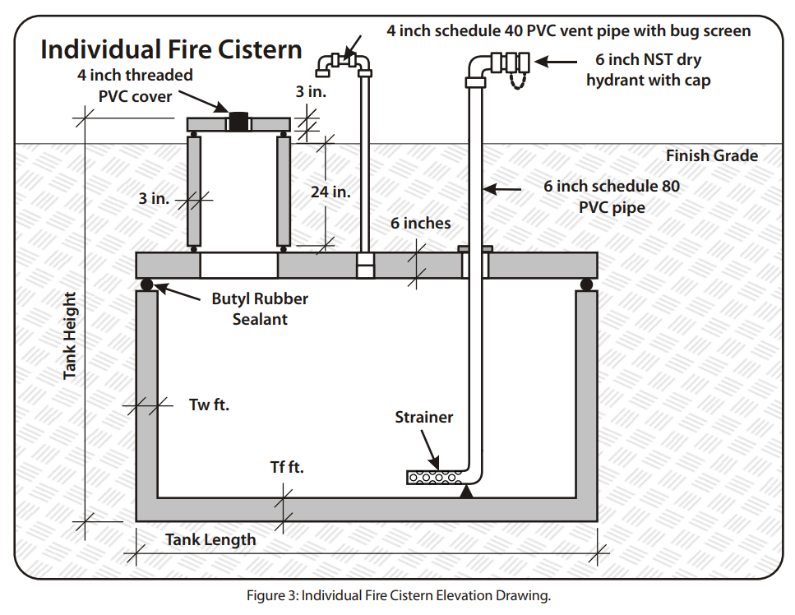
Basic Concept
Fire Protection Cistern Primer
Tanks are typically Steel or Fiberglass / Plastic, concrete can be used as well.
Buried below the frost line or above ground and insulated with an immersion heater
May or may not require a manhole, will require access / inspection port
6 in NST dry hydrant, gravity feed prefered
Not required to have a pump
Vented
30K gal tank is 12 ft diameter x 40 ft
Smaller tanks chained together can be more economical (3x 10k gal)
This is more applicable to a single home cistern consisting of a tank and lid, but close enough

Slide 11
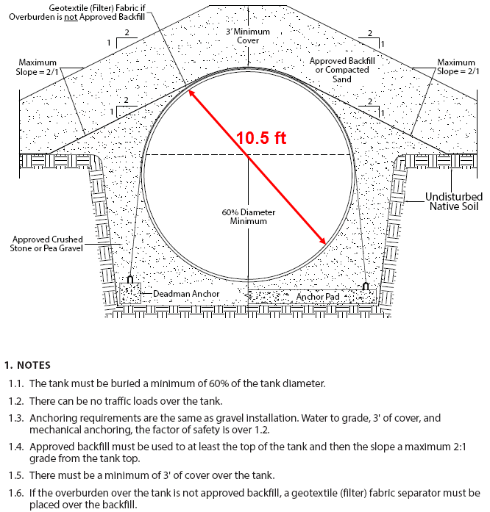
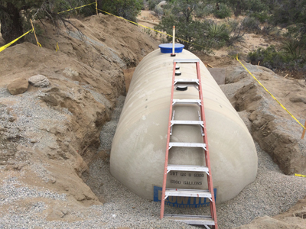
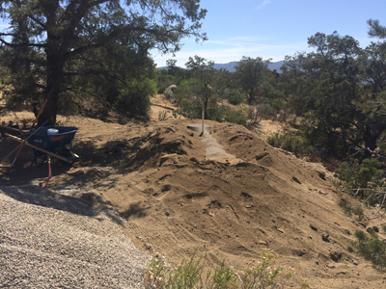
Typical Tank Installation
Gravel / Sand, typically 1 ft buffer around
Desert / warm climate install, frost line requirements not identical
National Storage Tank Recommendations

Slide 12
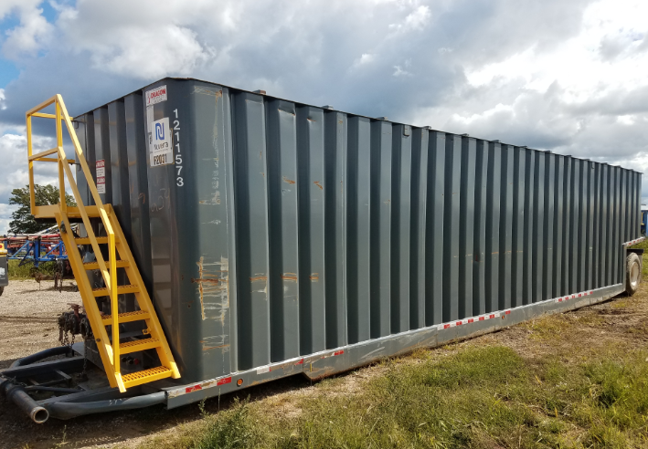
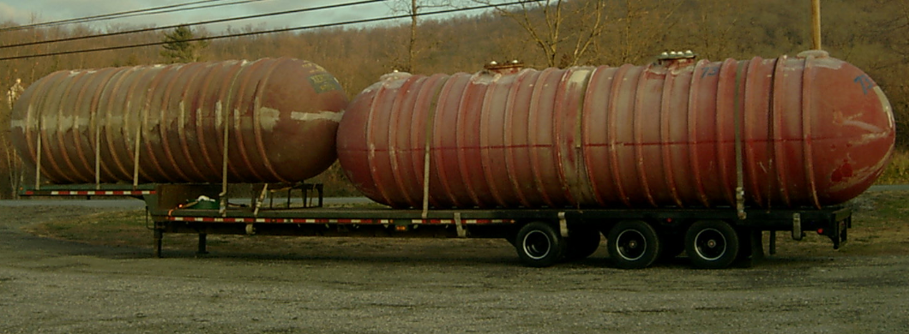
Used Tank Options
Used frack water tank (22k gal) $10-22K
Weldments and modifications ($4,000)
Transport ($2,000)
Need two to meet capacity requirements
Used underground fuel tanks
Up to 30k gal
$8-12K plus transport
Generally fiberglass / plastic
Harder to install than steel tanks, difficult to inspect / risk
50,000 gal used JetA tank, $32k
Details pending

Slide 13
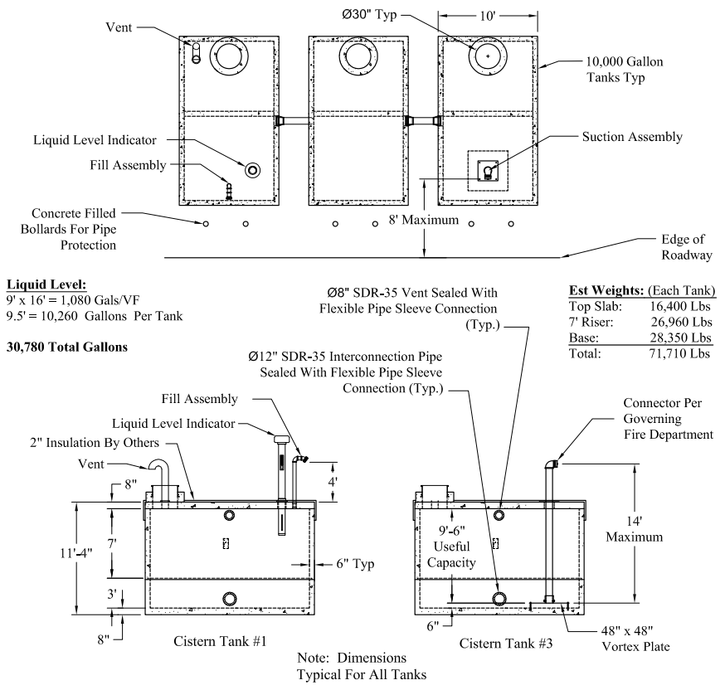
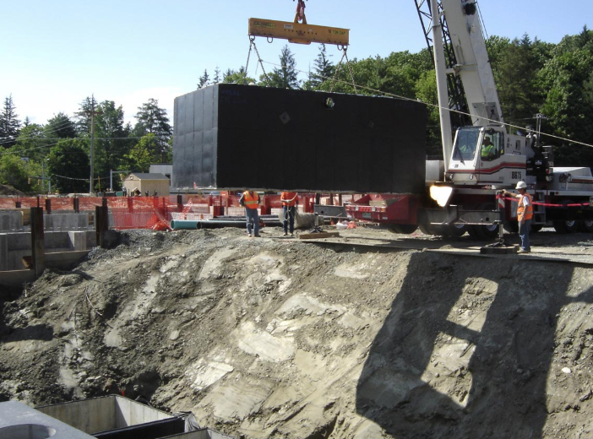
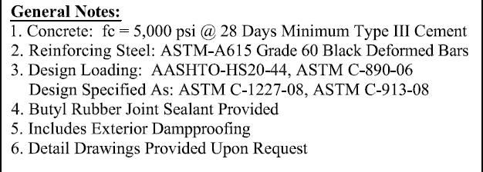
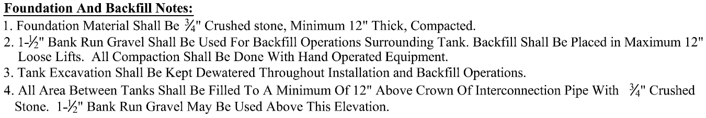
Precast Concrete Cisterns
Oldcastle Precast tanks $15k / 10k gal tank plus transport and crane

Slide 14
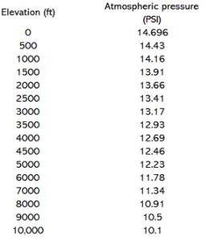
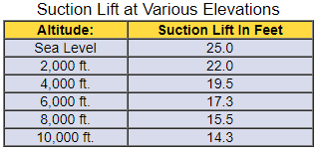
Estimated maximum draft (head)
Suction Lift with no losses
Taking into consideration the surrounding atmospheric pressure and friction loss in the intake hose, every fire pump in good repair should be able to lift water at least 15 feet (at sea level).
Ratio 10.5/14.7=.71
15 X .71 = 10.7 ft (estimate for RR)

Slide 15
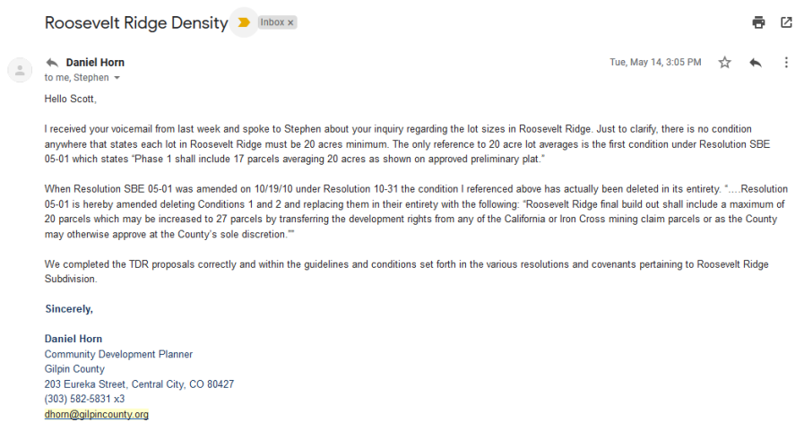
Roosevelt Ridge Density

Slide 16
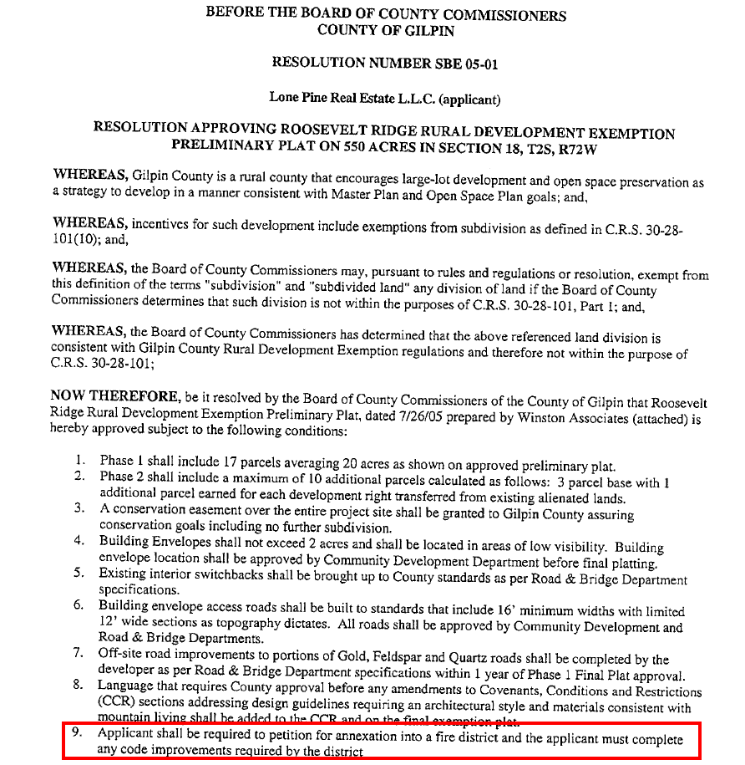
SBE 05-01 Fire District Code Improvements

